Slide 1
3D Building Creation and Visualization in ArcGIS Pro
Presented by: Frank Chau
GEOG 483 Tutorial Presentation (Winter 2020)

Slide 2
Agenda
3D Building Creation
Data and Tools Used
Converting a 2D footprint layer to a 3D layer
3D Visualization
Fully Customized symbology
Pre-defined rule packages
Additional Resources
Notes:
Can shorten the agenda – half min -> 10-15 seconds

Slide 3
3d building creation

Slide 4
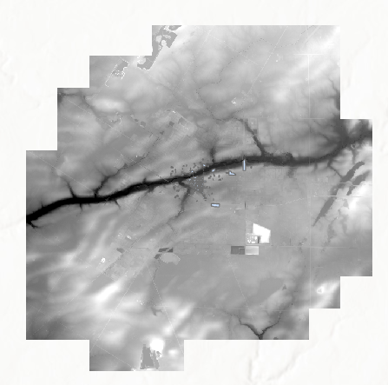


Data and Tools Used
Data: City of Stratford Data
Heritage Properties (Polygon SHP)
Contains approximate height values of the heritage buildings
Digital Terrain Model (DTM) (Raster)
Shows the ground elevation in the city
Tools
ArcGIS Pro
ArcGIS Online (optional)
Figure 1: Stratford heritage footprint layer with a DTM model
Notes:
- Builds on what Logan has mentioned in his lecture

Slide 5
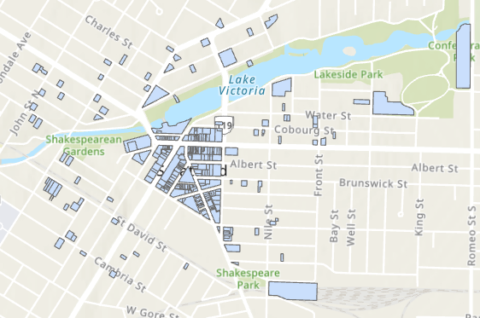
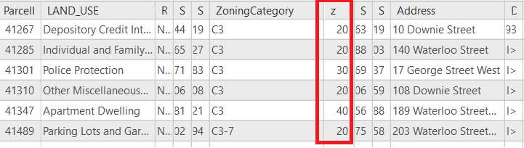
Converting a 2D footprint layer to a 3D layer
Make sure that there is a z-value field, which shows the elevation from ground of each building.
For this tutorial, the z-values are populated with the approximate heights of each building.
To achieve higher accuracy, height values can be determined using DSM (not covered in this tutorial).
Figure 2: Stratford heritage footprint layer
Figure 3: Attribute table of the footprint layer with a z-value field

Slide 6
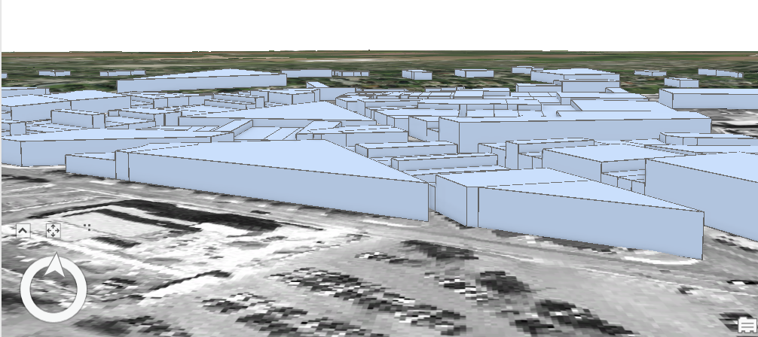
Converting a 2D footprint layer to a 3D layer (cont’d)
Extrude building footprints
Create a new Scene in ArcGIS Pro.
Set the elevation surface to be the DTM.
Navigate to the Extrusion toolbar (Feature Layer > Appearance > Extrusion group).
Choose an extrusion type based on your need:
Figure 4 : Extruded Stratford footprint layer
Extrusion Type | Description
Min Height | Extrusion is added to each building’s minimum height.
Max Height | Extrusion is added to each building’s maximum height.
Base Height | Extrusion is added to each vertex of each feature’s base height.
Absolute Height | Each building is extruded to the specified z-value as a flat top (One SINGLE z-value).

Slide 7
3D VISUALIZATION
Fully Customized Symbology

Slide 8
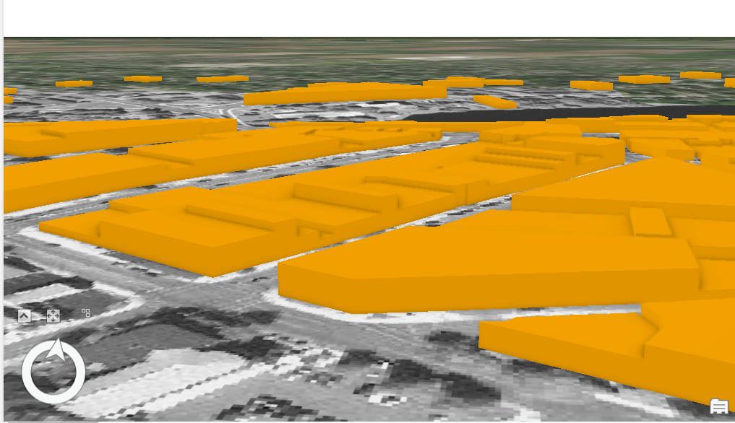
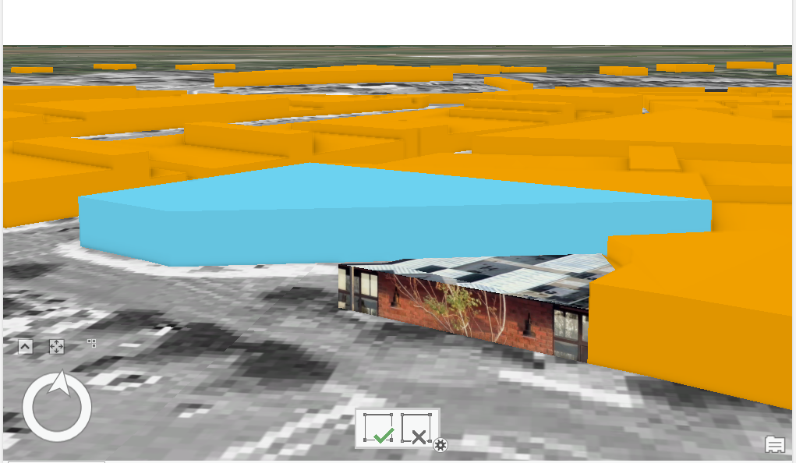
Customized Symbology for 3D Buildings
Figure 5 : Original Multipatch footprint layer
Figure 6: Customized Multipatch footprint layer
Multipatch Layer
Customized Buildings
Extruded building footprints are converted to Multipatch features using Layer 3D To Feature Class tool
Buildings with customized texture and colors can be produced by using the Multipatch Texture tool

Slide 9
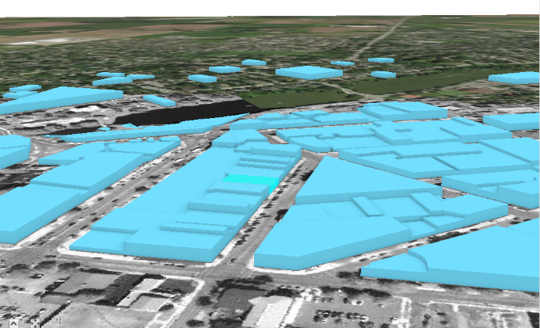
Advantages and Disadvantages
Advantages
Each building surface can be customized by the user
No external plug-ins or settings required
Disadvantages
Time-consuming for customization of many buildings (e.g. in a city or town)
Multipatch features cannot be published easily on a web platform due to large graphics
Figure 7: Multipatch footprint layer

Slide 10
3D VISUALIZATION
Pre-defined rule packages

Slide 11
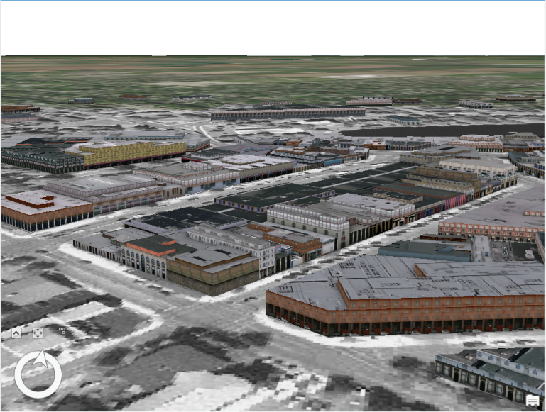
Pre-defined rule packages by ESRI
ESRI has provided a number of rule packages for the customization of 3D buildings.
Example: Int_City_2014.rpk
A selection of building types
High-rise buildings
Office buildings
Apartment buildings
Residential buildings
Can choose building shape, roof texture and specify the ground height
For the building height, attribute mapping can be applied so that the z-value field is used as the reference for the building height.
Figure 8: Stratford building layer with International City (2014) rule package by ESRI

Slide 12
Demo

Slide 13
Advantages and Disadvantages
Advantages
Can add texture to the whole city/town model in a very short time period
Typically more visual appealing than the results produced from the fully customized method
Disadvantages
Less degree of customization compared to the previous method (i.e. the texture of all building features are defined by the rule package, detailed customization for each surface of an individual building cannot be done)
External rule packages (.rpk) files need to be downloaded from online sources and loaded to ArcGIS Pro, so more setup is required

Slide 14
Sharing of Results
Save as a Layer Package
Can be saved locally
Or can be uploaded to ArcGIS Online if you have an online account
Export as a map image
Save as an image file (JPG, PNG, TIFF …) showing a screenshot of your built 3D city/town model
Note: There is an option for sharing the Multipatch layer as a web layer to be shown in Web Scene on ArcGIS Online. Due to large amount of graphics, the Multipatch layer may not be displayed in your web scene. Therefore, this way of file sharing is NOT recommended.

Slide 15
Additional Resources
Tutorial Material (PDF)
Obtaining elevation information for building footprints
https://desktop.arcgis.com/en/arcmap/10.3/guide-books/extensions/3d-analyst/3d-buildings-obtaining-elevation-information-for-building-footprints.htm
Extrude features to 3D symbology (ESRI)
https://pro.arcgis.com/en/pro-app/help/mapping/layer-properties/extrude-features-to-3d-symbology.htm

Slide 16
THANK YOU FOR LISTENING!

Slide 17
Credit
Stratford building data and DTM are used in GEOG/PLAN 387 provided by Dr. Robert Feick in the School of Planning of the University under his permission.

